Slide 1
Lead Score Case Study
Done by: Lakshmi Narashimman . D

Slide 2
Problem statement
An education company X education sells some courses online and many visit its website daily. People fill the form and become its leads. But only 30 out of 100 leads get converted for them as sales.
As its lead conversion rate is poor, it want to improve its conversion rates by identifying the hot leads that are likely to convert.
The company wants us to build model that predicts whether a lead converts or not.
The CEO of the company want his company to improve the sales conversion rate to 80% (80 out of 100 leads should be converted into sales).

Slide 3
Business objective or goals
1. To build a logistics regression by assigning a lead score of 0 to 100 to identify potential leads for conversion. If the score is higher, it means the lead is hot and will convert. Else, it is cold and will not convert.
2. Your model should be adaptable to the company's requirements in the future so that it could handle the future problems well

Slide 4
Steps to solve this lead scoring problem
1. Import the libraries and data
2. Read and Understand the data
3. Data Cleaning
4. Data Preparation for the model and Exploratory Data Analysis
5. Model building
6. Model Evaluation
7. Making predictions on the test set

Slide 5
Exploratory Data analysis – Findings (Part -1)
Management subjects have the highest number of leads generated and converted.
The conversion rates of business administration, media and advertising, banking, travel and tourism, international business and E-commerce are high.
Both direct traffic and google has the highest number of leads generated and converted compared to other sources.

Slide 6
Exploratory Data Analysis – Findings (Part-2)
The conversion rates of referral sites. reference, Welingak website and Olark chats are higher.
Lead add form and API has high conversion rates compared to the landing page submissions
SMS Sent and email opened has the highest number of conversions
Leads that spend enough time on the website have greater chances to be converted
In order to make leads spend more time, the website should be more engaging

Slide 7
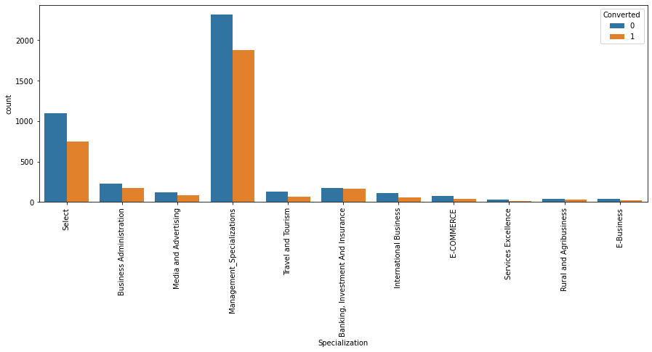
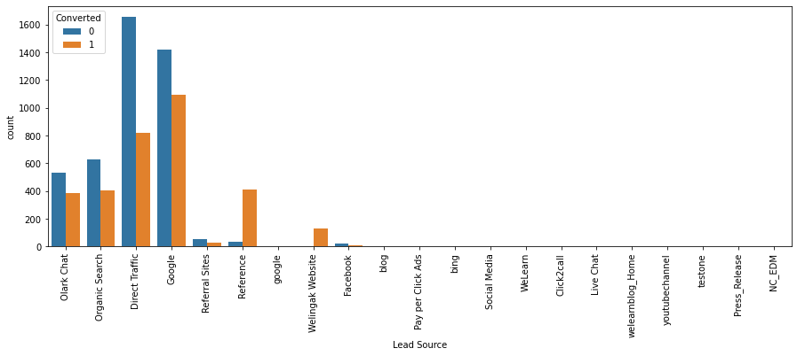
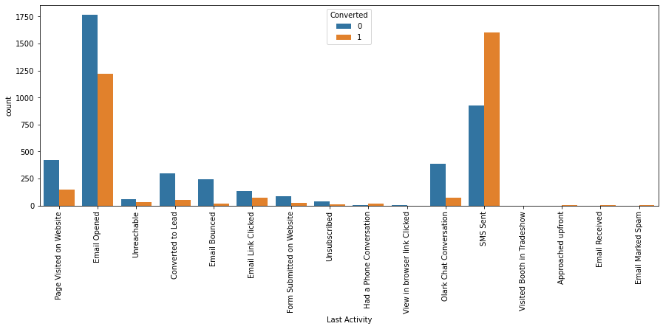
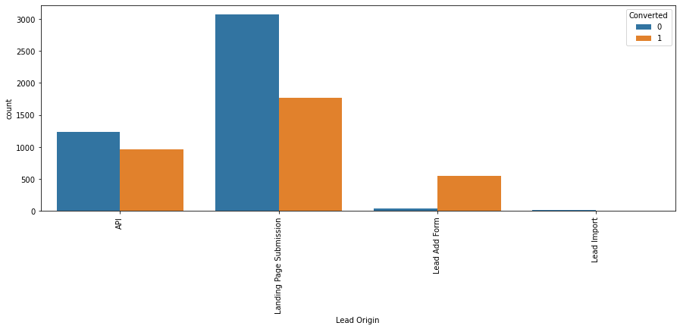
EDA – Visualizations

Slide 8
Variables used to predict conversions after EDA, Scaling, and feature elimination
Total Visits
Total Time Spent on Website
Page Views Per Visit
Lead Source_Olark Chat
Lead Source_Reference
Lead Source_Welingak Website
Do Not Email_Yes
Last Activity_Email Bounced

Slide 9
Variables used to predict conversions after EDA, Scaling, and feature elimination (Contd)
Last Activity_Had a Phone Conversation
Last Activity_Olark Chat Conversation
Last Notable Activity_Email Bounced
Last Notable Activity_SMS Sent
Last Notable Activity_Unreachable
We have totally filtered out 13 features to predict lead conversions, after doing EDA, Feature scaling and feature elimination. These 13 features are used for logistics regression model building and evaluation.

Slide 10
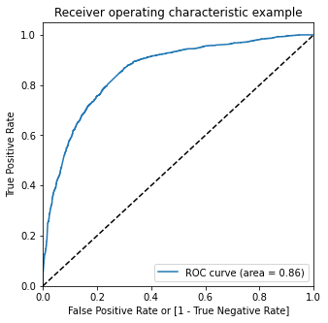
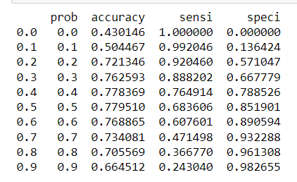
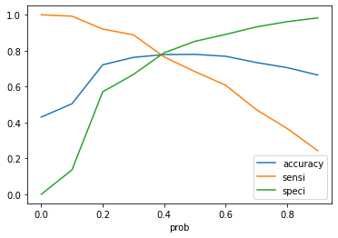
Optimal cut-off point is 0.42 using ROC Curve
We can see that around 0.42, we get the optimal cutoff point where all these measures intersect.
Also, we can see that at point of 0.4, the accuracy, sensitivity and specificity are almost nearby and similar.
Let us decide the optimal cutoff point for probability as 0.42.

Slide 11
Train and test data comparison for evaluation metrics at 0.42 cut off using sensitivity and specificity
Evaluation metrics for the "train data" at 0.42 cutoff
- Accuracy - 78.1%
- Sensitivity - 75.1%
- Specificity - 80.3%
# Evaluation metrics for the "test data" at 0.42 cutoff
- Accuracy - 77.3%
- Sensitivity - 75.8%
- Specificity - 78.5%

Slide 12
Comparison of Train and test data evaluation metrics for 0.44 cutoff found using precision recall trade off
Evaluation metrics for the "training data" at 0.44 cutoff using precision recall trade off
- Accuracy - 78.0%
- Precision - 74.9%
- Recall - 73.4%
Evaluation metrics for the "test data" at 0.44 cutoff for the precision recall trade off
- Accuracy - 77.3%
- Precision - 73.1%
- Recall - 74.3%

Slide 13
Overall findings for this model
The variables that mattered the most for potential buyers are:
Total time spent on website
Total number of visits
Lead sources like google, direct traffic, organic and Welingak websites
SMS and Olark chat conversations is the last activity before conversion
The lead origin is lead add format
By keeping these in mind and focusing on the improvement of these variables, X education can obtain more lead conversions.

Slide 14
Thank You

